Slide 1


Strategies for Scripting and Automating
ESRI DEVELOPER SUMMIT 2023
Nick Giner
John Yaist
Notes:
Esri Corporate Template-Dark v4.1
January 5, 2022

Slide 2

Online Questions
After the Event!
Thank you for joining us. Please feel free to ask questions throughout the session with Pigeonhole.
We will answer live and Pigeonhole questions during our Q&A.
If we’re unable to answer your question, we’ll do our best to answer them in Pigeonhole during the conference or follow up directly if you provide your name.

Slide 3

Slides and Notebooks – will be available!
After the Event!
Esri Proceedings site - Slides
ArcGIS API for Python Public Repo – Notebooks
On the conference_talks in the talks directory
Website address: https://github.com/Esri/arcgis-python-api

Slide 4

Agenda
Overview of Python in the ArcGIS Platform
Why Python?
Demos
Resources

Slide 5
Why Python?
Why is it in ArcGIS
Why should I bother?

Slide 6









Why Python?
Scientific computing
Package management
Interface consistency
Platform agnostic
Domain experts could accomplish tasks
No matter the computing environment
No matter the skill level
Notes:
* Recent explosive growth
* Ease of package management – solving dependency issues
* Non-experts increase domain productivity
No matter the computing environment
No matter the skill level
Consistency of interfaces
You know what you’re going to get
Knowledge transferrable outside domain expert –
Copy each other’s homework

Slide 7











Python Everywhere
Enterprise
API for Python
Hosted Notebooks
Insights
Raster Analytics
GeoAnalytics
Enterprise
Pro
ArcPy
Drone2Map
Business Analyst
Workflow Manager
Desktop
Local Server
Local Server
Local Server
.NET
Java Qt
Runtime
Azure GeoAIDSVM
AWS Lambda
3rd party systems

Slide 8


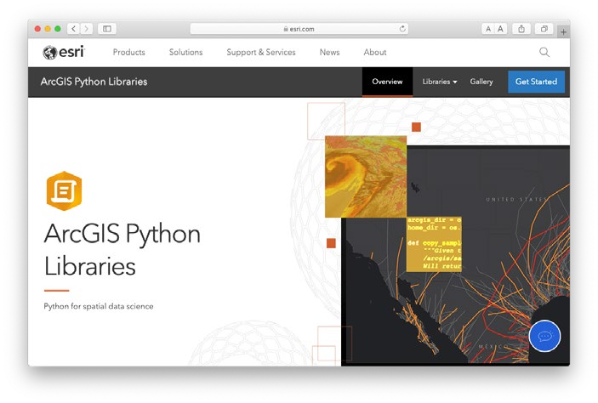



ArcGIS Python Libraries: ArcPy and ArcGIS API for Python
ArcPy
ArcPy + ArcGIS API for Python
ArcGIS API for Python
Maps and projects
Deep access to Pro with simple code
1700+ geoprocessing tools
Manage web layers, maps, and tools
Deploy anywhere
Build geospatial deep learning models
Do everything with Python
Jupyter Notebook rich integration
Seamlessly blend web layers and local analysis
Comprehensive and powerful library for spatial analysis, data management, and conversion.
Lightweight library for analyzing spatial data, managing your Web GIS, and performing spatial data science.
Pro
Enterprise
Online

Slide 9
How do we deliver Python
Runtime – all that’s necessary to execute code properly
ArcGIS Pro
arcgispro-py3 Conda environment – ArcGIS API for Python + ArcPy + ~300 other libraries
ArcGIS Online (ArcGIS Notebooks in Online) Runtimes
Standard – ArcGIS API for Python + ~370 Python libraries
Advanced – ArcGIS API for Python + ArcPy ~380 Python libraries
ArcGIS Enterprise (Notebook Server) Runtimes
Standard – ArcGIS API for Python + ~370 Python libraries
Advanced – ArcGIS API for Python + ArcPy ~380 Python libraries

Slide 10
Where can you script and automate?
Here, There, and Everywhere!
ModelBuilder
Pro Python Window
ArcGIS Notebooks (Pro, Online, Enterprise)
Jupyter Notebooks
Python IDEs (PyCharm, Spyder, PyDev, Sublime Text, Visual Studio, etc.)
ArcGIS Scheduled Notebooks (Online, Enterprise)
ArcGIS Notebook Web Tools

Slide 11

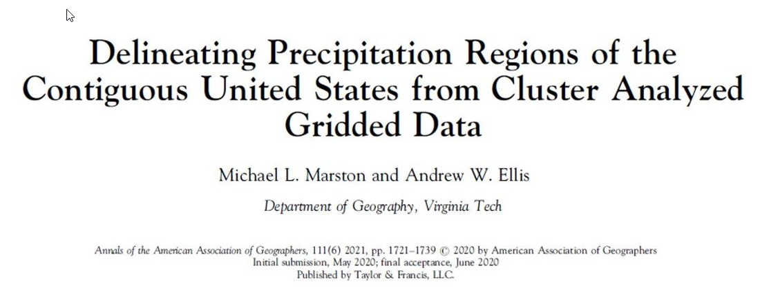
ArcGIS Pro Use Case
Nick Giner

Slide 12
ArcGIS API for Python
Administration
Content Management

Slide 13
Python 3.9
ArcGIS Pro 3.0 and Enterprise 11
Python 3.9 arrived with Pro 3.0 (and Enterprise 11)
Some deprecations - especially in the collections module
Test code to ensure script dependencies have Python 3.9 packages

Slide 14
Resources
Help and Samples
List of Python libraries in runtimes:
ArcGIS Pro – Work with Python packages
ArcGIS Enterprise and ArcGIS Online - ArcGIS Notebook Runtime Manifests
Code Samples:
ArcPy – ArcGIS Pro Python reference
ArcGIS API for Python – Sample Notebooks, Scripting with ArcGIS API for Python

Slide 15
Conclusion
Python integrates across the platform
The ArcGIS Python libraries are more accessible
Python provides the best of the open source world and GIS

Slide 16





Connect With Us On Social
And Join the Conversation Using #EsriDevSummit
twitter.com/EsriDevs
twitter.com/EsriDevEvents
youtube.com/@EsriDevs
links.esri.com/DevVideos
github.com/Esri
github.com/EsriDevEvents
links.esri.com/EsriDevCommunity
#esridevsummit, #esridevsummit23

Slide 17



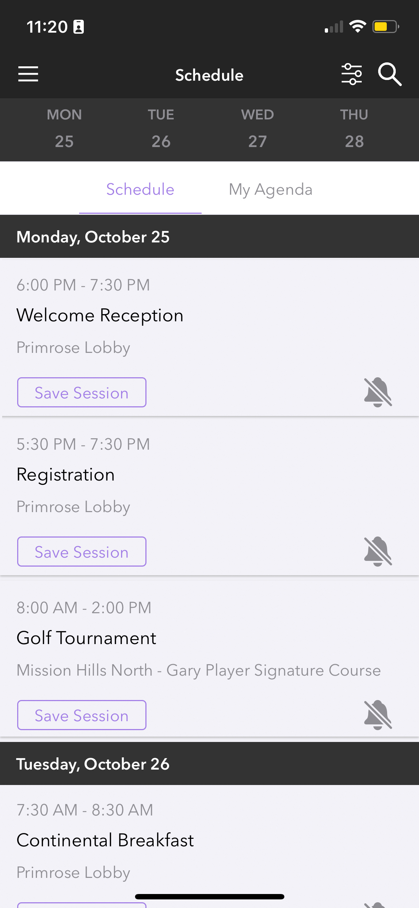
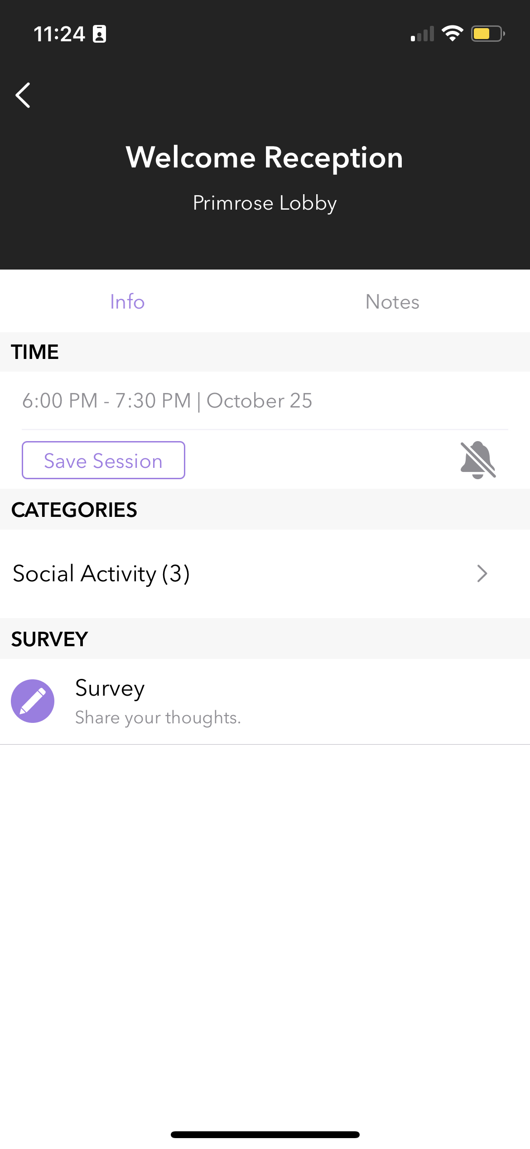
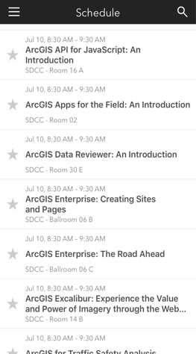
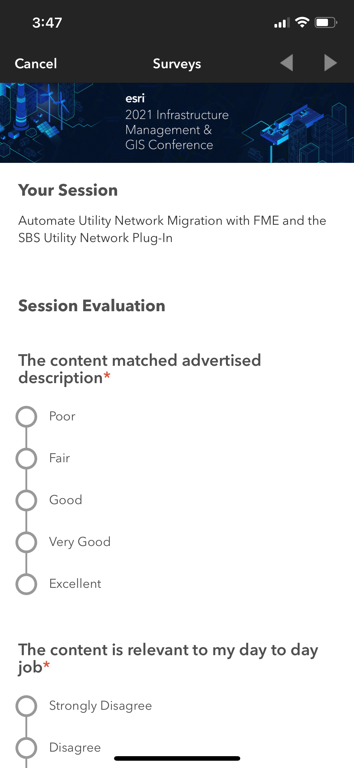
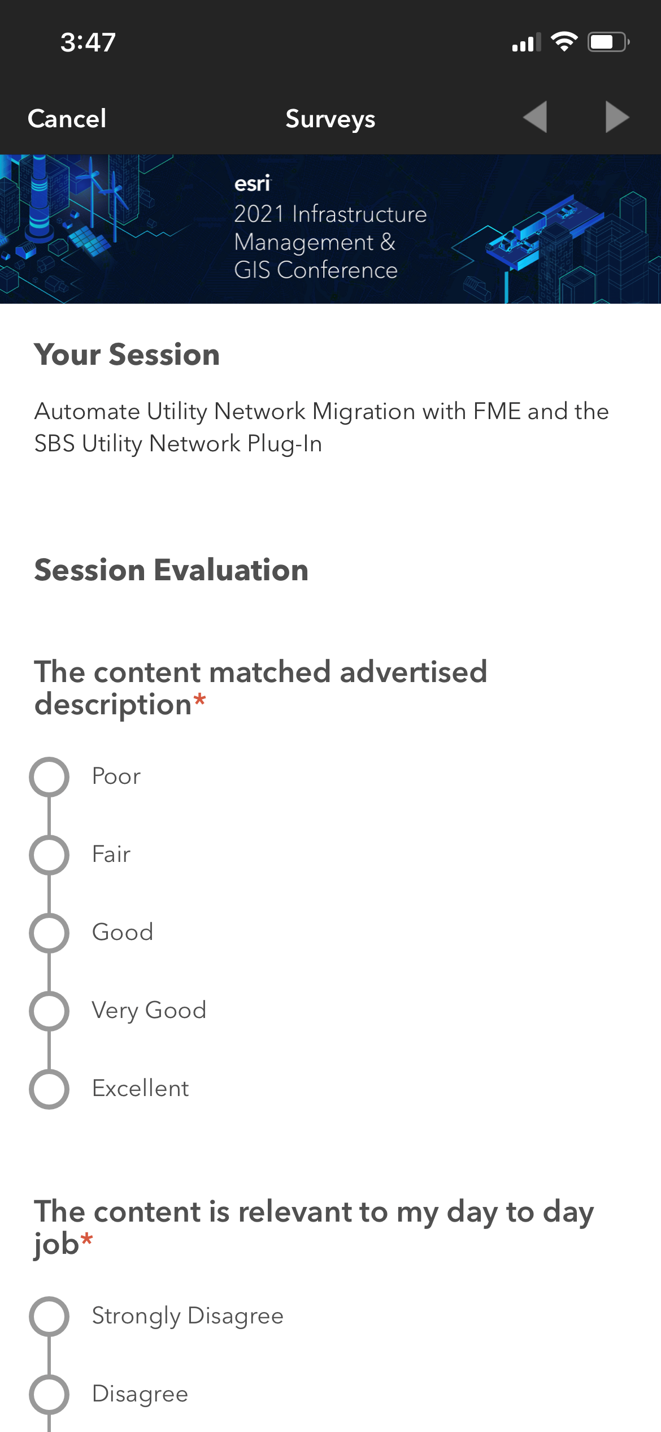

Please Share Your Feedback in the App
Download the Esri Events app and find your event
Select the session you attended
Scroll down to “Survey”
Log in to access the survey

Slide 18



Copyright © 2023 Esri. All rights reserved.

